Slide 1
Osher Lifelong Learning Institute, Winter 2026
Critical Economic Topics for 2026
Bradley University
Host: Jon Haveman, Executive Director
National Economic Education Delegation

Slide 2
National Economic Education Delegation
Vision
One day, the public discussion of policy issues will be grounded in an accurate perception of the underlying economic principles and data.
Mission
NEED unites the skills and knowledge of a vast network of professional economists to promote understanding of the economics of policy issues in the United States.
NEED Presentations
Are nonpartisan and intended to reflect the consensus of the economics profession.

Slide 3
Who Are We?
Honorary Board: 54 members
2 Fed Chairs: Janet Yellen, Ben Bernanke
6 Chairs Council of Economic Advisers
Furman (D), Rosen (R), Bernanke (R), Yellen (D), Tyson (D), Goolsbee (D)
3 Nobel Prize Winners
Akerlof, Smith, Maskin
Delegates: 652+ members
At all levels of academia and some in government service
All have a Ph.D. in economics
Crowdsource slide decks
Give presentations
Global Partners: 48 Ph.D. Economists
Aid in slide deck development

Slide 4
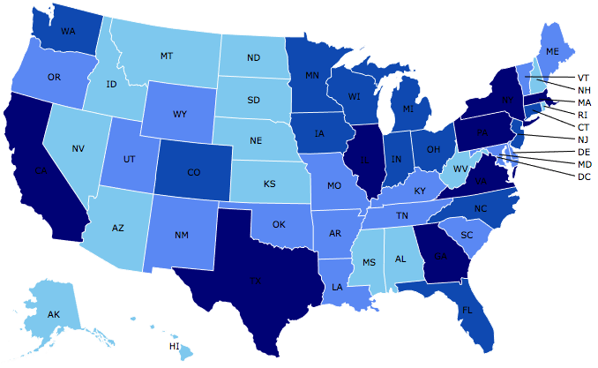
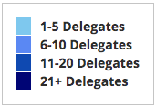
Where Are We?

Slide 5
Available NEED Topics Include:
US Economy
Healthcare Economics
Climate Change
Economic Inequality
Economic Mobility
Trade and Globalization
Minimum Wages
Immigration Economics
Housing Policy
Federal Budgets
Federal Debt
Black-White Wealth Gap
Autonomous Vehicles
US Social Policy

Slide 6
Course Schedule
Critical Economic Topics for 2026
Week 1 (2/04): Economic Update, Geoffrey Woglom, Amherst College
Week 2 (2/11): Monetary Policy, Geoffrey Woglom, Amherst College
Week 3 (2/18): U.S. Federal Budget, Jon Haveman, Executive Director NEED
Week 4 (2/25): International Institutions, Alan Deardorff, University of Michigan

Slide 7
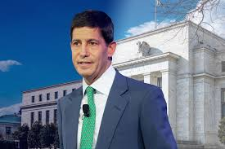
Monetary Policy under New Fed Chair
Kevin Warsh: Trump Nominee to replace Jerome Powell as the Chair of the Fed in May

Slide 8
What Does the US Govt. Budget Look Like?
2024 Budget Summary (in Trillions)
Revenue |  |  | Outlays
Income Taxes | $2.4 |  | Mandatory | $4.1
Payroll Taxes | $1.7 |  | Discretionary | $1.8
Corporate Taxes | $0.5 |  | Interest | $0.9
Other | $0.3
Total | $4.9 |  | Total | $6.8
Budget Deficit: $1.8 Trillion
Source: https://www.cbo.gov/publication/60053
Notes:
https://www.cbo.gov/publication/53627
https://www.cbo.gov/publication/53624

Slide 9

Main Economic Institutions
Notes:
https://sbhshgovapmacro.wordpress.com/2011/06/02/international-institutions/

Slide 10
Submitting Questions
I encourage questions. Raise your digital hand or put questions in the chat
We will do a verbal Q&A once the material has been presented.
Slides will be available from the NEED website tonight https://needecon.org/delivered_presentations.php.
My Google site: https://sites.google.com/view/macro-current-issues/home

Slide 11
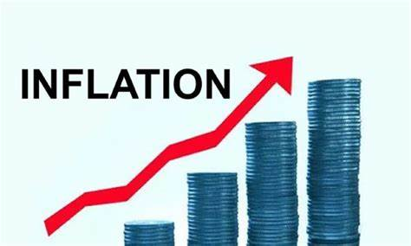

US Economy: Update
Geoffrey Woglom,
Professor of Economics
Amherst College, emeritus
February 4, 2026

Slide 12
Outline for the Talk
Overview of State of the Economy: Close to Fully Recovered
The Importance of Stable Inflationary Expectations in the Economy’s Successful Recovery.
Outlook for the Future.
The Fed’s Current Policy Dilemma.

Slide 13
The Goal of Macroeconomic Stabilization Policy
The Fed’s Definition:
Get the economy to the highest levels of GDP and employment while,
Keeping inflation low and stable, or at 2%
What about the climate change; poverty, health care?

Slide 14
Gross Domestic Product: 2025Q3 = $31.1 tr
$31.85
Less Imports
-$4.12
Plus Exports
+$3.37
Equals GDP
$31.1

Slide 15
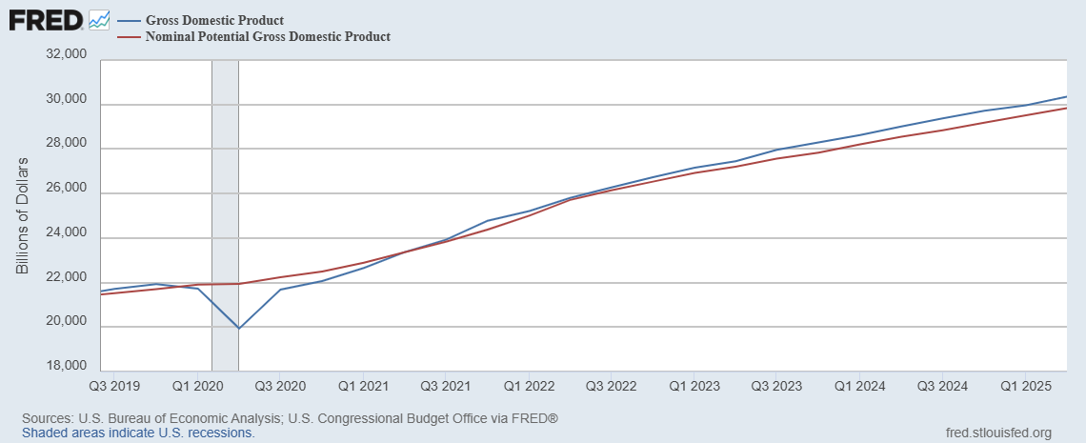
GDP and ‘Potential’ during the Recovery
Grey bar indicates recessions
Source: Fred, St Louis Fed

Slide 16
What is a Recession?
Defined by the National Bureau of Economic Research (NBER)
“The NBER's definition emphasizes that a recession involves a significant decline in economic activity that is spread across the economy and lasts more than a few months.”
Popular Rule of Thumb: Two or more, consecutive quarters where Real GDP falls. (Doesn’t always work!)
Recessions are caused by a drop in total spending (remember the consumer).

Slide 17
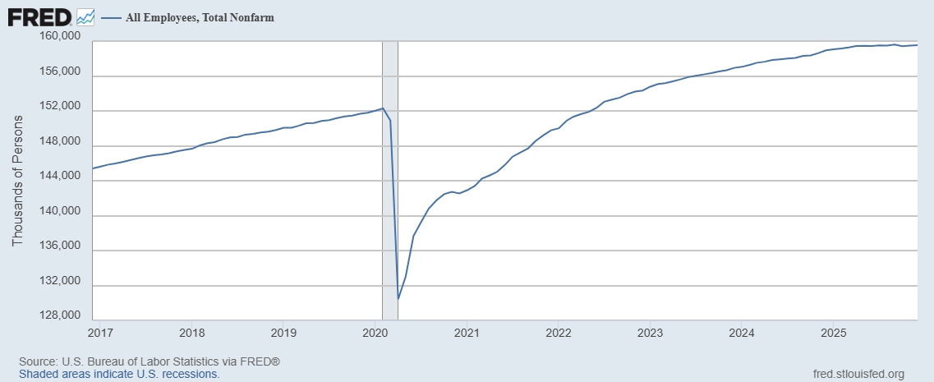
Where Have All the Workers Gone?
Aging of the Labor Force
Also, note the recent slowing in job growth.
Source: Fred, St Louis Fed

Slide 18
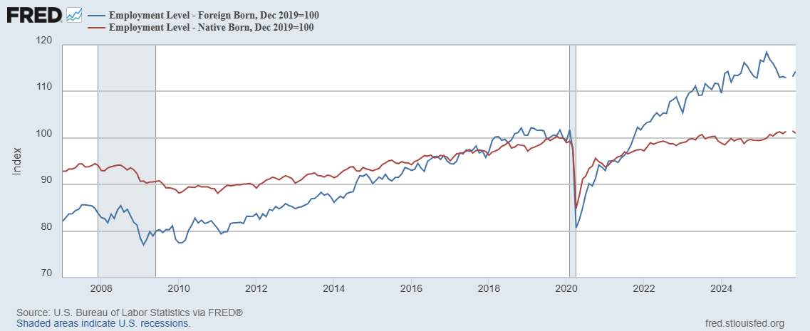
Could Have Been Worse , but for Foreign Born Workers
Between 12/19 and 3/25
NB employment fell by 100k
FB employment rose by 5000k
Since March FB employment
fell by 1100k

Slide 19
New Jobs Added per Month

Slide 20
The Kerfuffle Over the Jobs Reports
BLS conducts 2 surveys each month
Household Survey: Unemployment Rate.
“Establishment” Survey (workplace survey): Number of new jobs created.
August 1 Report: 73,000 jobs added July, but May and June numbers were revised down by 280,000.
Trump fires BLS director, the same day.
What is behind those “revisions?”
Want to learn more: “An Unresponsive Public is Undermining Government Economic Data,” WSJ, 9/15, at
https://sites.google.com/view/macro-current-issues/economic-update

Slide 21
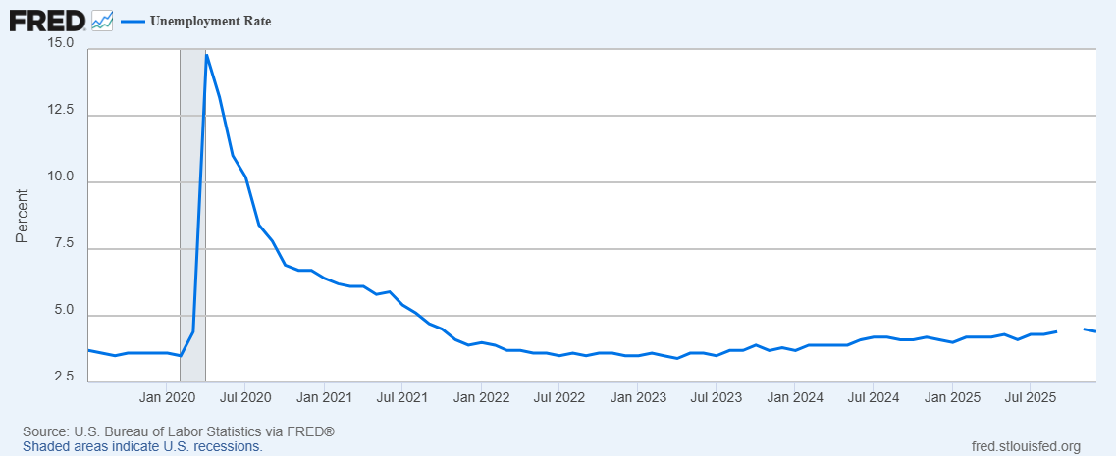
Unemployment is Near Record Lows
But, it has been rising: From 3.4 percent in 4/23 to 4.4 percent in December

Slide 22
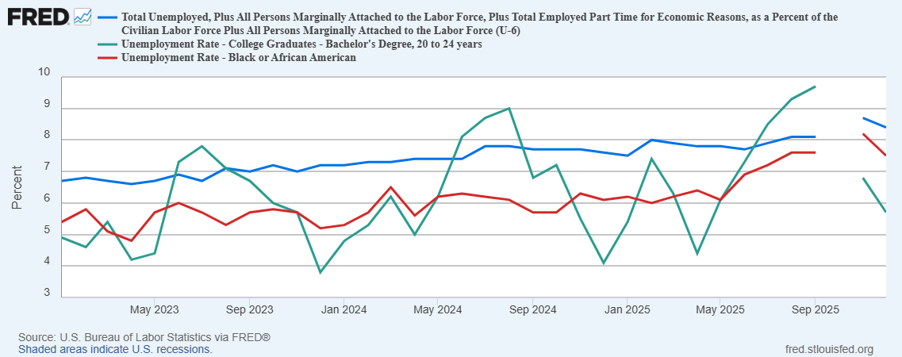
More Detail on Unemployment

Slide 23
The Real Side of the Economy is Still Good
GDP is very close to its potential.
The labor market as measured by the unemployment rate is fully recovered.
Macro Goal number 1, check
But what about goal number 2, the “nominal” side of the economy

Slide 24
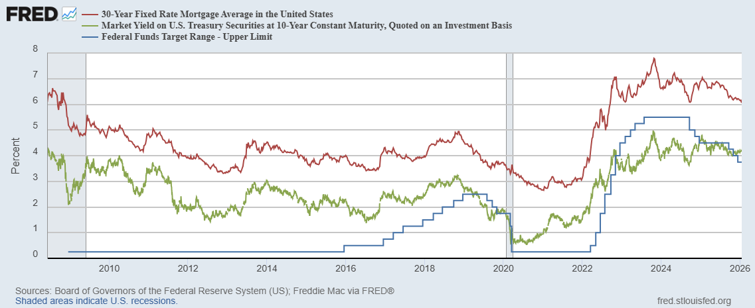
Interest Rates: Era of Falling Rates Over?
Notes:
Fed policy rate 4.5 to 4.25. Concerns with inflation

Slide 25
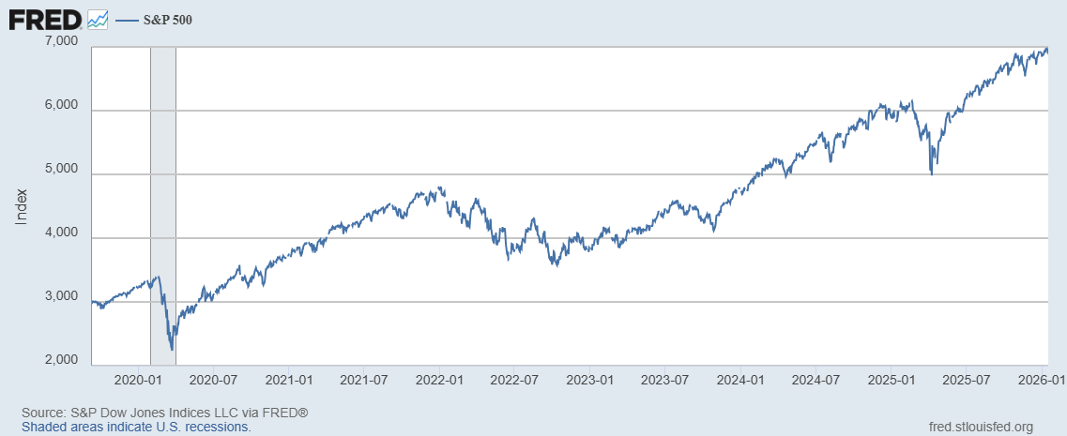
Stock Prices: Tariffs; What Tariffs?
Notes:
Since the end of 2021, lost almost 15%

Slide 26
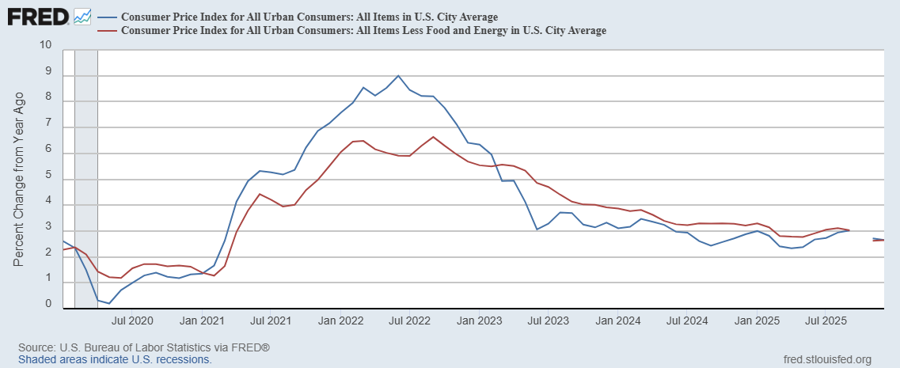
Inflation during the Recovery (CPI)
Notes:
August CPI yoy 8.3% down from 8.5 and Core 6.3 up from 6.3 in JUly

Slide 27
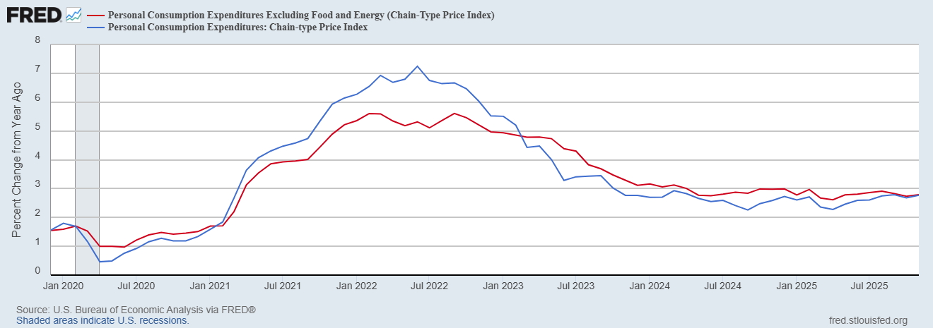
Fed’s Measure (PCE)
Inflation Accelerates 3/2021
Fed Doesn’t React until 3/2022
Progress towards the 2 % slows Spring 2024
But so far, not much sign of tariffs in inflation

Slide 28
CPI vs. PCE: Differences
CPI tends typically to be 0.3 pct point higher
November:
CPI, 2.7%
PCE, 2.8%
Core CPI, 2.6%
Core PCE, 2.8%.
https://www.morningstar.com/markets/whats-difference-between-cpi-pce

Slide 29
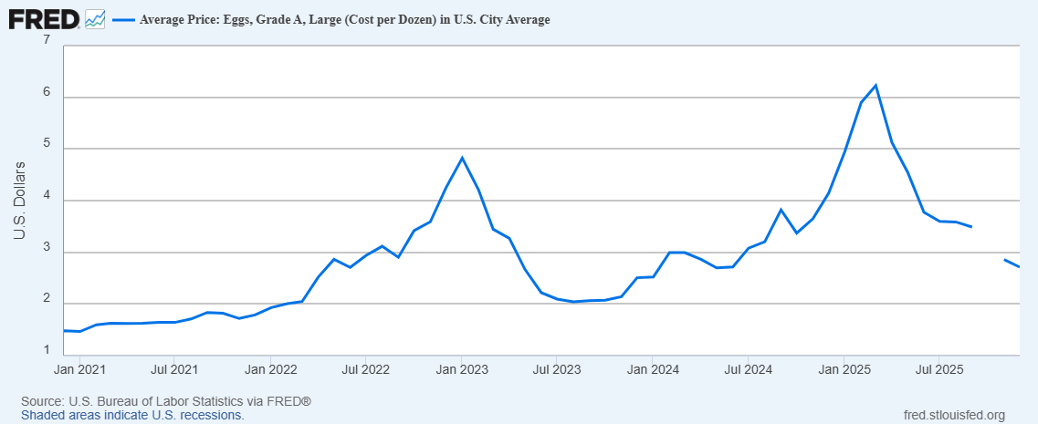
Uses of Inflation Measures
Two Reasons for Measuring Recent Inflation:
What has happened to the Cost of Living?
What is likely to happen to inflation over the next 12-18 months?

Slide 30
Wage Growth
Sources: https://www.atlantafed.org/chcs/wage-growth-tracker & BLS via https://fred.stlouisfed.org/

Slide 31
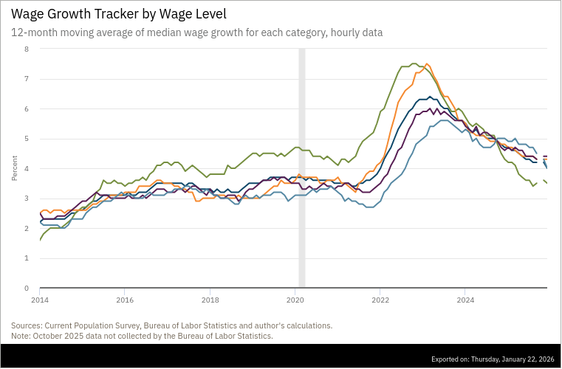
Low-Wage Workers Experience

Slide 32
“Affordability”
Notes:
113 127 128 123 123

Slide 33
The State of the Economy & How We Got Here
The key indicators for judging the macro economy are all good
Output and unemployment are close to their “full employment” levels
Inflation is still a bit elevated, but much improved over 2023.
21-22
Too much demand due to easy monetary policy and a fiscal stimulus which was probably too big
COVID Supply disruptions exacerbated inflation.
23-present Monetary Policy Close to Perfect
Inflation has fallen substantially with small increase in unemployment, and we are close to the 2 percent target (unprecedented reduction without a recession)

Slide 34
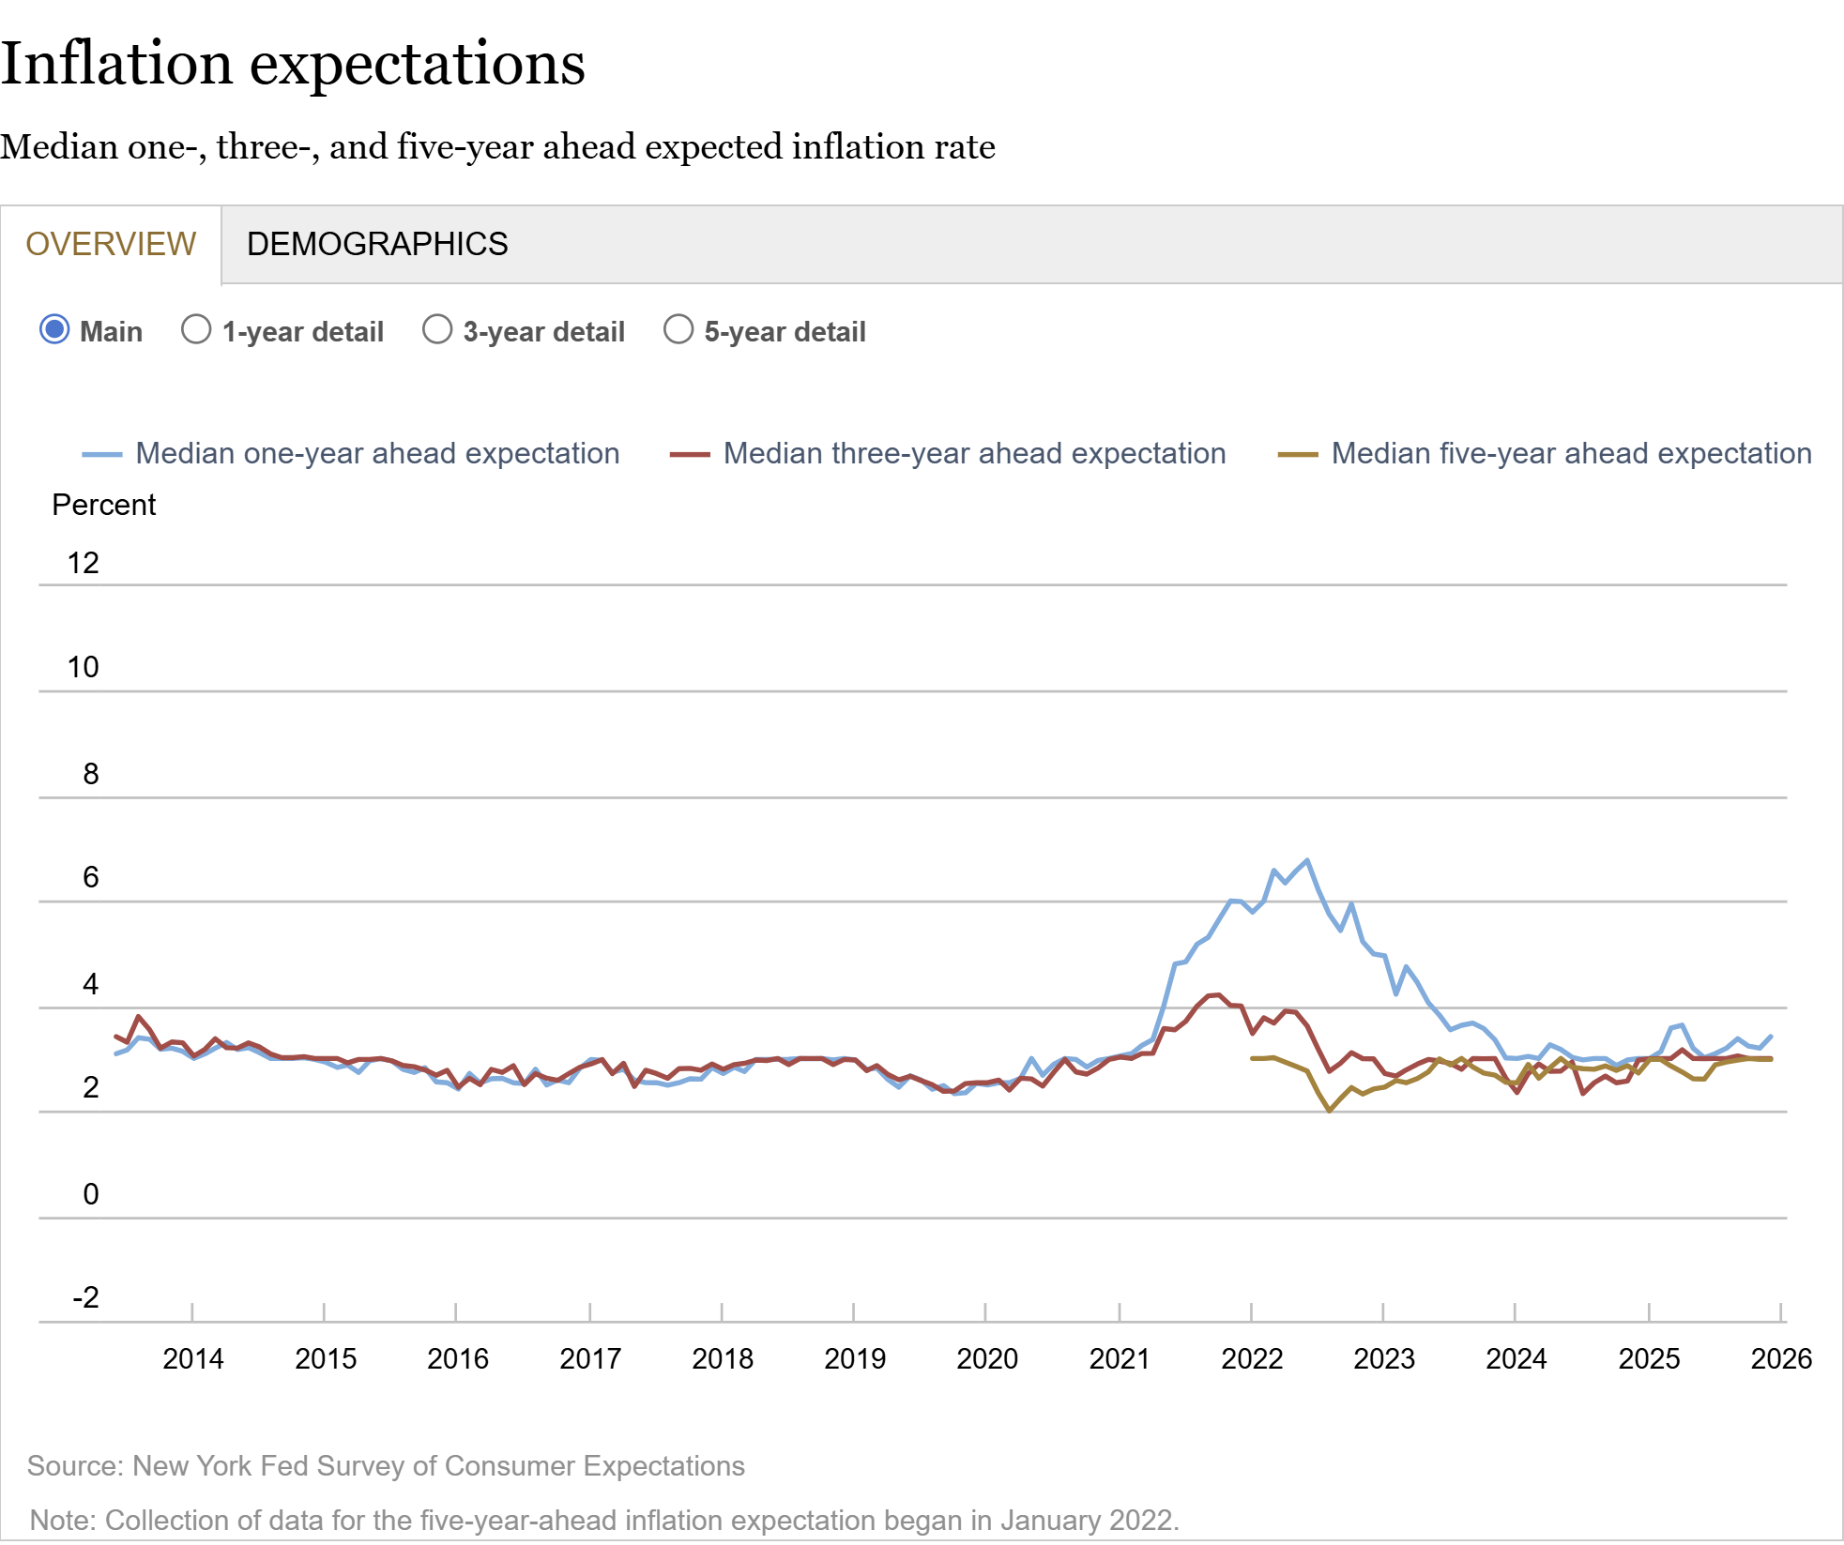
How Did the Fed Do It?
The Key to Success:
Stable, Anchored Inflation Expectations

Slide 35
Unstable, Unanchored Inflation Expectations

Slide 36
The Outlook Is More Complicated
Areas of Strength
Tax Refunds (refundable credits: EITC Child Tax Credit, overwithholding).
Continued AI Investment
Areas of Concern:
Consumer Spending.
Slowing of Employment Growth, particularly among young, blacks and BAs. (already talked about)
Fiscal Policy Effects.
Uncertainty.
Monetary Policy: Next 4 months and under the New Chair, Kevin Warsh (?)

Slide 37
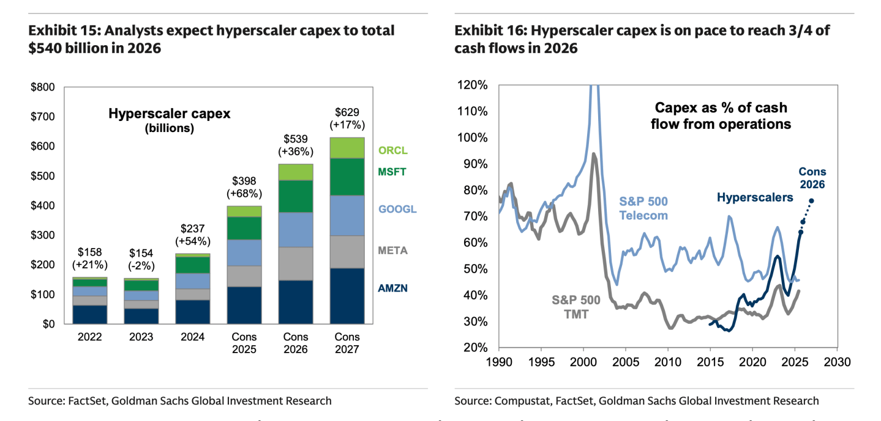
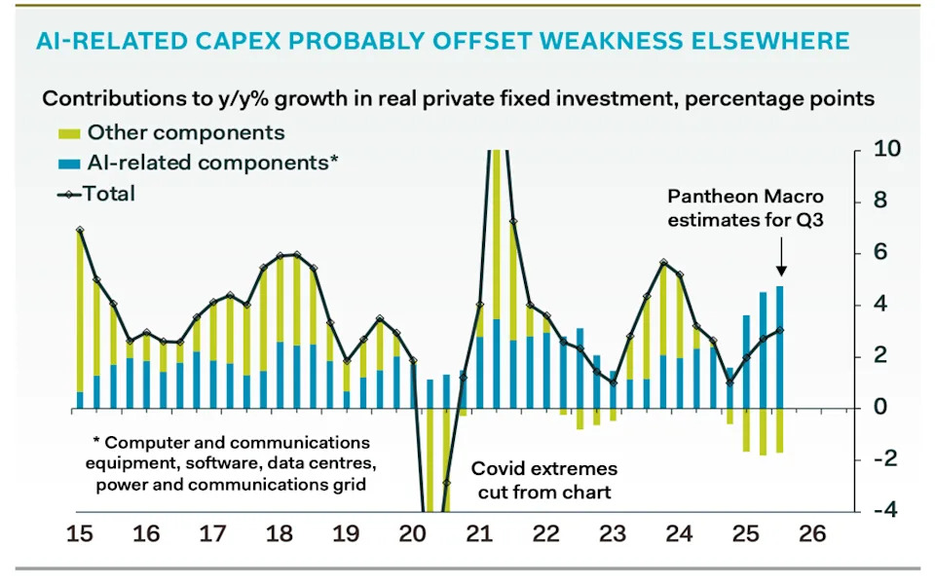
AI and Investment
Source Parthenon: Macroeconomics
Between 24Q3 and 25Q3: AI investment increased by about $360 billion; all other investment fell by $130 billion. Increase in AI investment was over 20% of increase in total GDP

Slide 38
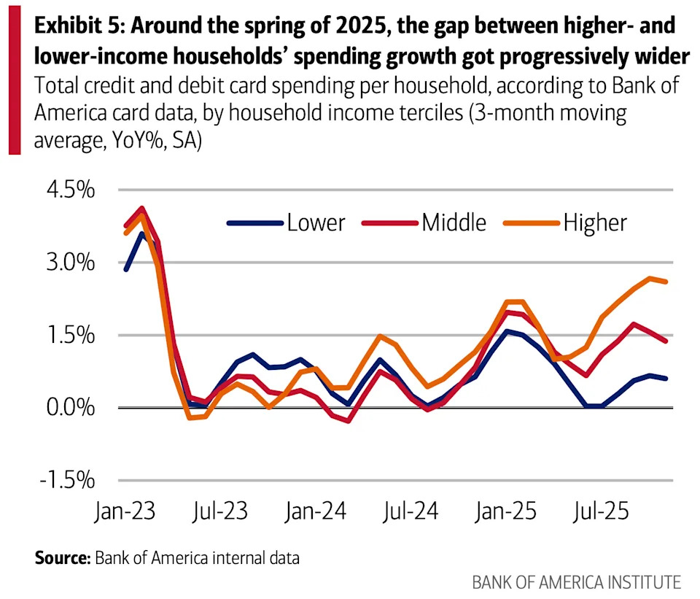
Consumption
Low-Income Consumers look vulnerable
Moody’s Top 20% account for 63% of Consumption

Slide 39
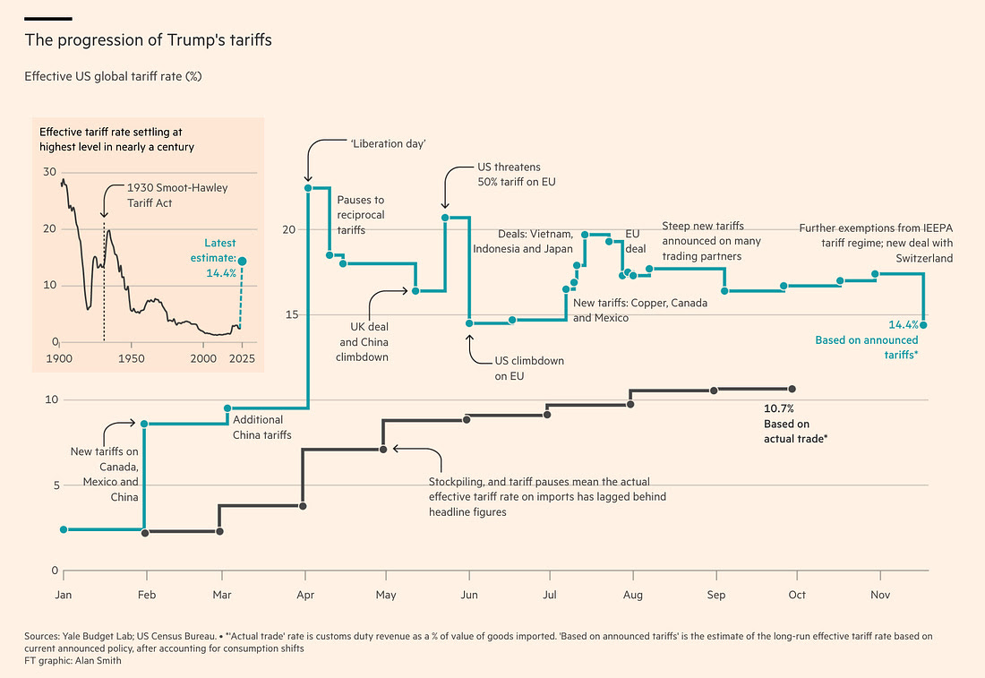
FiscalPolicy: Tariffs
This Chart is Very Confusing!

Slide 40
Tariffs: Distributional Effects

Slide 41
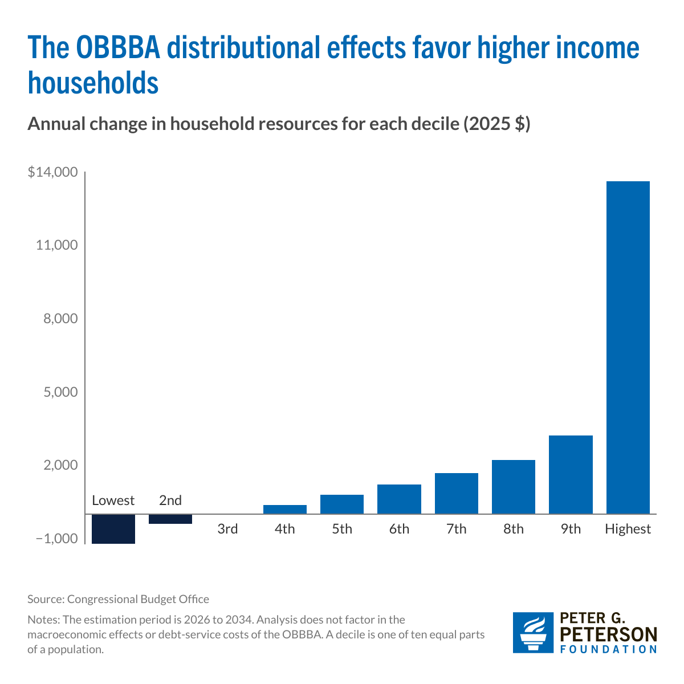
Fiscal Policy: OBBBA
Lowest: -$1,214
2nd: -$392
3rd: 0
4th: 379
5th: 797
6th: 1,211
7th: 1,673
8th: 2,213
9th: 3,208
10th: 13,622

Slide 42
Combined Effects: Distributional
Lowest: -$2,134
2nd: -1,305
3rd: -1,076
4th: -735
5th: -541
6th: -309
7th: -30
8th: 246
9th: 922
10th: 9,751
How will these changes affect the spending of the less affluent; more affluent?

Slide 43
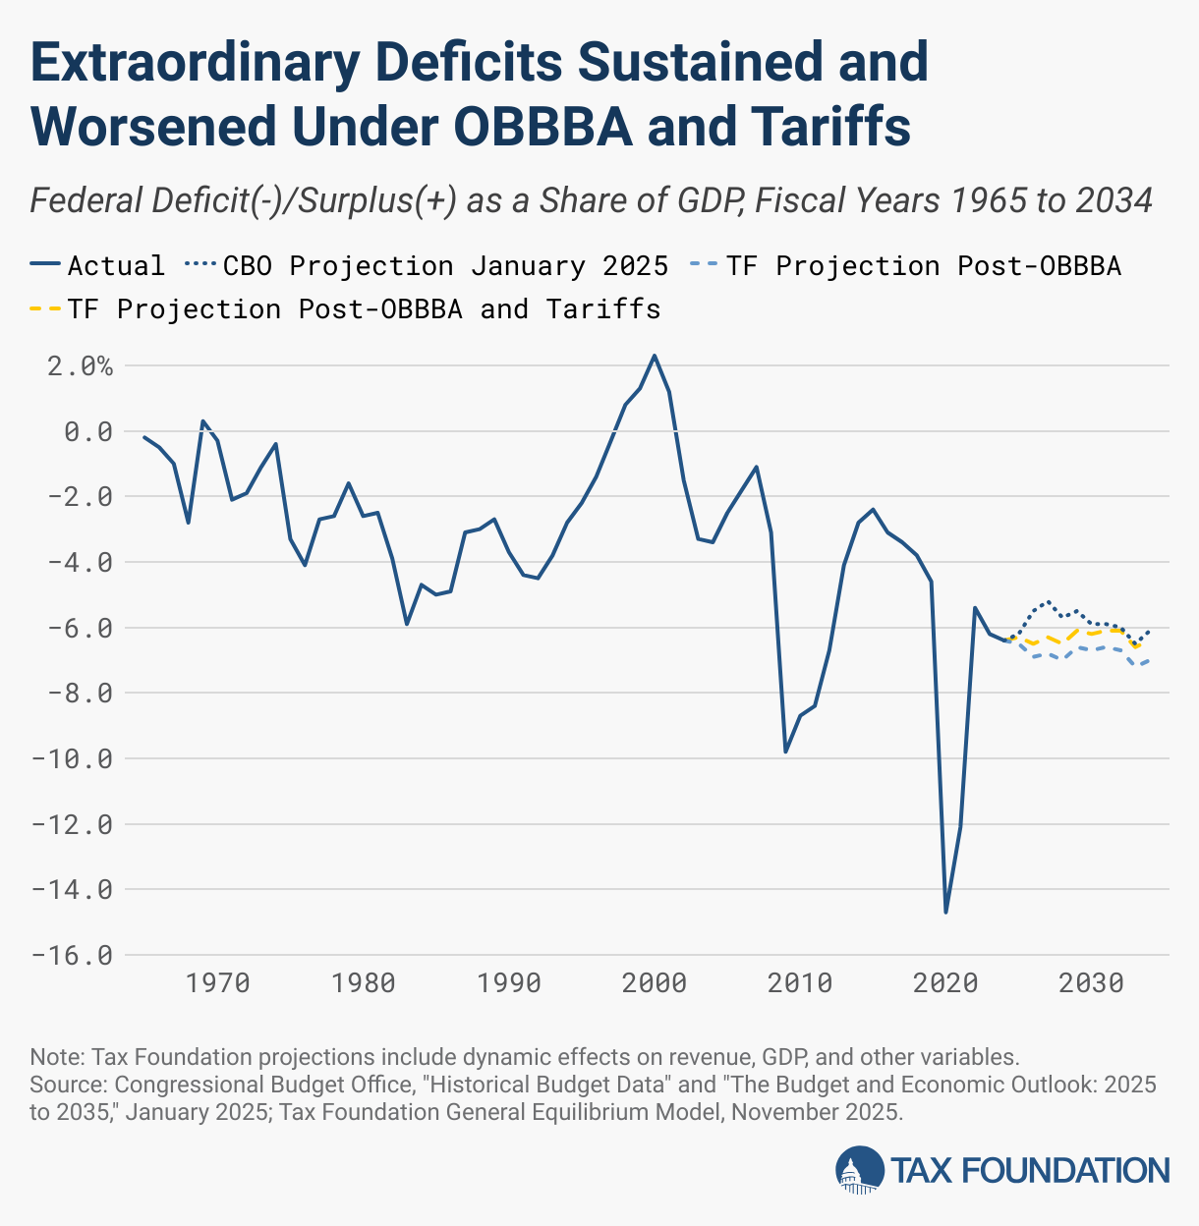
Combined Effects on the Budget Deficit
During 2025, tariff revenues collected were $264 billion.

Slide 44
Uncertainty
Tariff Volatility

Slide 45
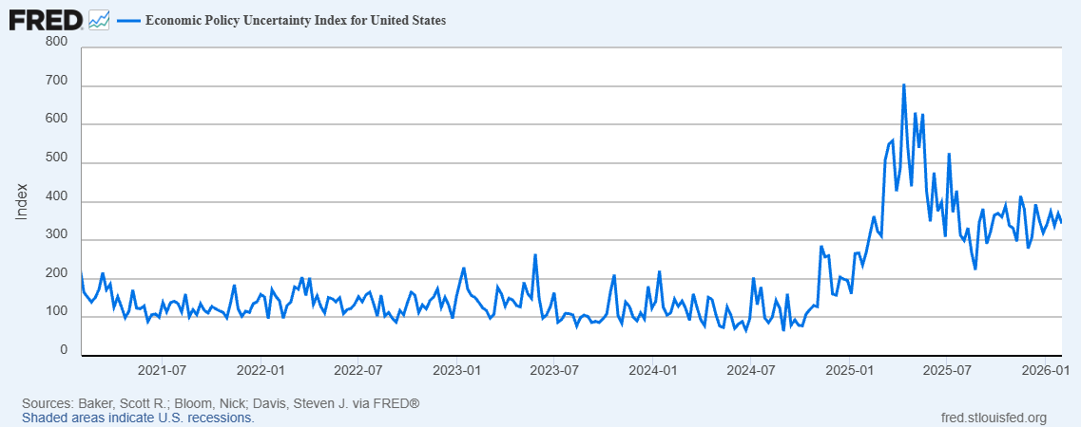
But… (Continued)
Uncertainty is Bad for the Economy’s Health (and there is a lot of it!)
How will these numbers change if:
Greenland negotiations breakdown
The Supreme Court rules Current Tariffs are illegal

Slide 46
But Wall Street Economists are Optimistic
WSJ, 1/18/2026

Slide 47
But, then there is Monetary Policy
The Fed’s Dilemma:
To combat rising unemployment the Fed needs to lower interest rates to increase demand and spending.
To combat rising inflation the Fed needs to raise interest rates to lower demand and spending.
Successfully navigating the path between the two problems is made worse because of attacks on the Fed’s independence which have the potential to destabilize inflationary expectations.
And, the uncertainty caused by the replacement of Powell by Kevin Warsh in May!

Slide 48
Next Week: Monetary Policy (to be cont.)
Kevin Warsh: Trump Nominee to replace Jerome Powell as the Chair of the Fed in May

Slide 49
Let’s Hear from You!
Geoffrey Woglom grwoglom@amherst.edu
Contact NEED: Info@NEEDEcon.org
Support NEED: www.NEEDEcon.org/donate.php

